Slide 1



Course: Image Processing 31651 Assignment #41 Noise and Median Filtration
Photo of the student | Shorten Name | ID (4 last digits)
 | shienfeld | 1950 | Student #1
 | pony | 2210 | Student #2
 | akimov | 7939 | Student #3
Photo of the student | Shorten Name | ID (4 last digits)
 | shienfeld | 1950 | Student #1
 | pony | 2210 | Student #2
 | akimov | 7939 | Student #3

Slide 2
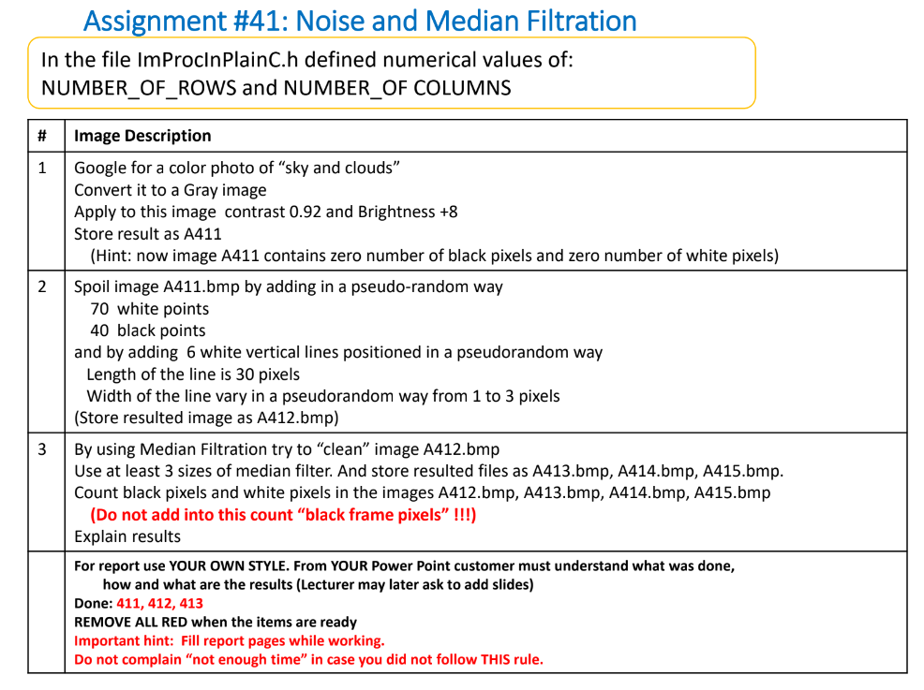

Slide 3
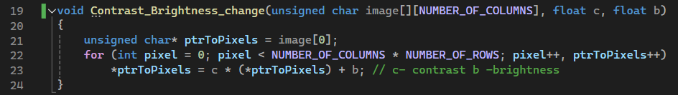
41.1 - first important function –”Contrast_Brightness_change”
obtaining a pointer to the first element of the image array. This pointer (ptrToPixels) will be used to iterate through all the pixels in the image.
for loop that runs through all the pixels in the image for covering every pixel in the 2D image array.
In addition : The pointer ptrToPixels is incremented to point to the next pixel in the image.
Inside the loop, each pixel value is adjusted by applying the contrast and brightness transformation: *ptrToPixels = c * (*ptrToPixels) + b.
note 1: c is a float representing the contrast adjustment factor. A value greater than 1 increases contrast, while a value between 0 and 1 decreases contrast.
note 2 : b is a float representing the brightness adjustment factor. Adding a positive value increases brightness, while adding a negative value decreases brightness.

Slide 4
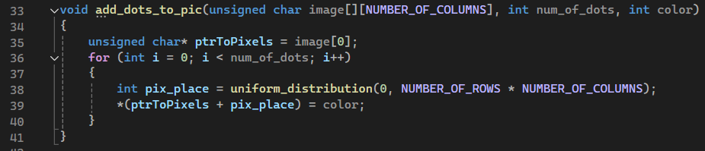
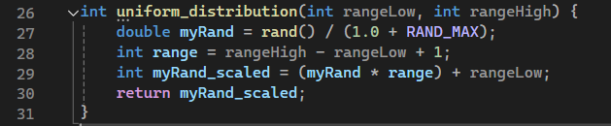
41.2 - second important function –” add_dots_to_pic”
obtaining a pointer to the first element of the image array. This pointer (ptrToPixels) will be used to iterate through all the pixels in the image.
A for loop runs num_of_dots times, adding one dot per iteration.
The function then sets the pixel at the random position to the specified color. It calculates the address of the random pixel by adding pix_place (the random position) to the base pointer (ptrToPixels) and then computes this pointer to set the pixel value.
Inside the loop, the function calls the function uniform_distribution to generate a random position within the bounds of the image. This ensures that the dots are placed at random locations. (see explanation below regarding uniform_distribution function)
The uniform_distribution function generates a random integer within a specified range, which is used to determine the random positions for the dots.
The function ensures that the dots are placed at random locations within the image.
Another important addition – set in the main – will be explained later

Slide 5
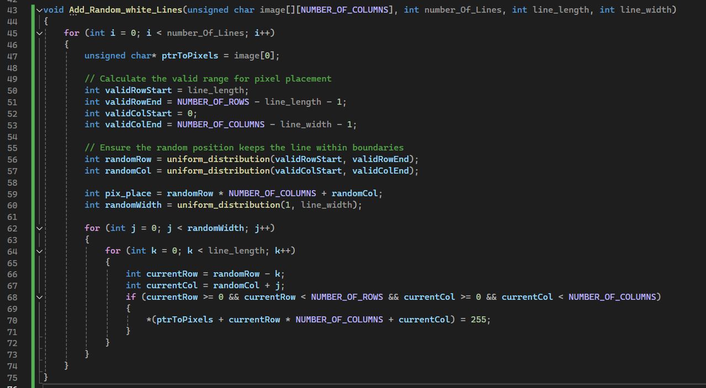
41.3 - third important function –” Add_Random_white_Lines”
A for loop runs number_Of_Lines times, adding one vertical line per iteration.
the function calls uniform_distribution to generate a random position within the bounds of the image. This ensures that the starting position of each line is chosen randomly.
The function calls uniform_distribution again to determine the width of the line.
This width is a random value between 1 and the specified maximum width (3).
Two nested for loops are used to set the pixel values for the line. The outer loop iterates over the width of the line, and the inner loop iterates over the length of the line.

Slide 6
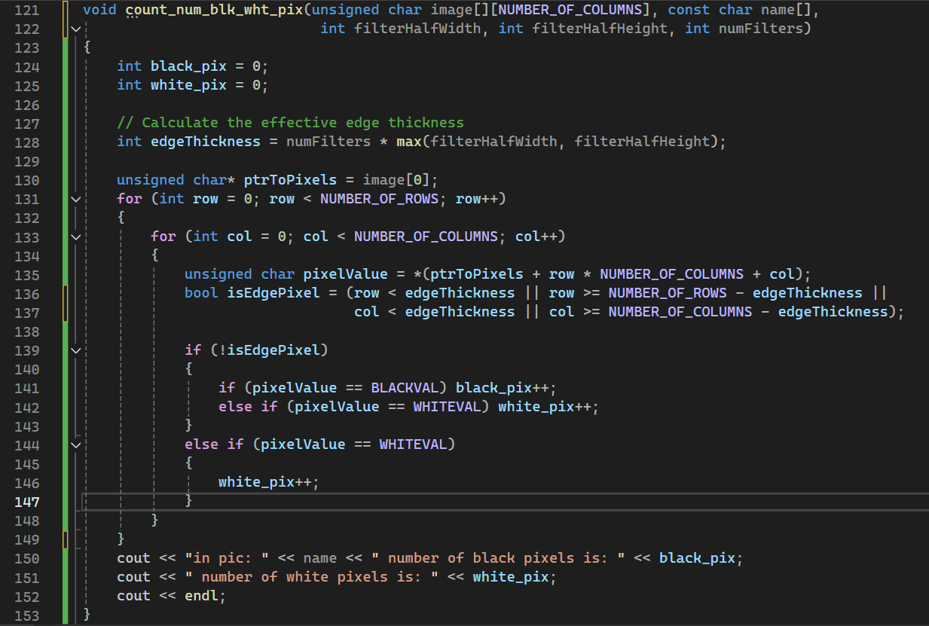
41.4 - fourth important function –” count_num_blk_wht_pix” – part 1
Deeper explanation about that function in the next slide!
We decided to pick that a certain approach to ensure that the count of black pixels remains accurate, even after multiple filtering operations that might introduce unwanted edge artifacts.
Will be explained deeper next slide.
The count_num_blk_wht_pix function counts the number of black and white pixels in a given grayscale image, while ignoring black pixels that are located on the edges of the image.
This is useful when multiple filtering operations have been applied to the image, which can introduce unwanted black pixels around the edges.

Slide 7
41.4 - fourth important function –” count_num_blk_wht_pix” – part 2
The function first calculates the effective edge thickness based on the number of filters applied and the filter dimensions.
The effective edge thickness is determined by multiplying the maximum of filterHalfWidth and filterHalfHeight by numFilters.
This value represents the number of rows and columns from the edges that should be considered as "edge pixels" and thus ignored in the black pixel count.
Inside the main for loop (line 131) , the function checks the value of each pixel:
If the pixel is not an edge pixel >>> If the pixel value is equal to BLACKVAL (which is defined as 0), it increments the black_pix counter.
If the pixel is not an edge pixel >>> If the pixel value is equal to WHITEVAL (which is defined as 255), it increments the white_pix counter.
If the pixel is an edge pixel >>> Only white pixels are counted by incrementing the white_pix counter. Black pixels in the edge region are ignored.
After the loop, the function prints the counts of black and white pixels using cout.
The printed message includes the name of the image and the counts of black and white pixels.

Slide 8
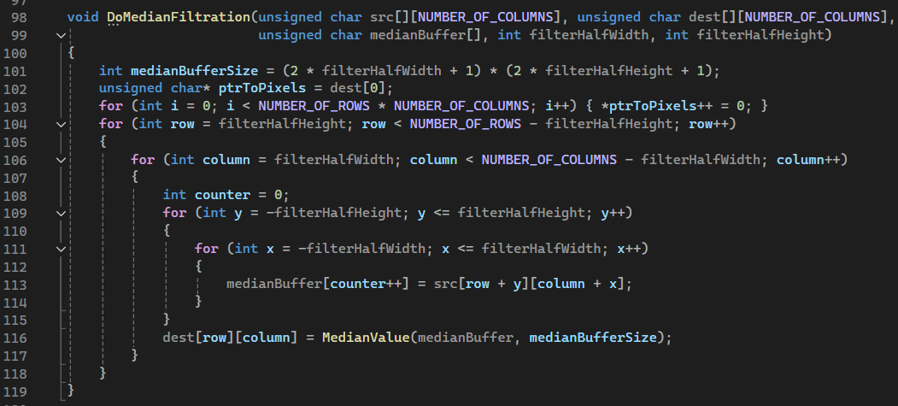
41.5-fifth important function –” DoMedianFiltration” – part 1
Explanation of the function – next slide – because of the major importance and complication of the function we will explain a bit deeper. We will explain the code step by step / part by part .

Slide 9
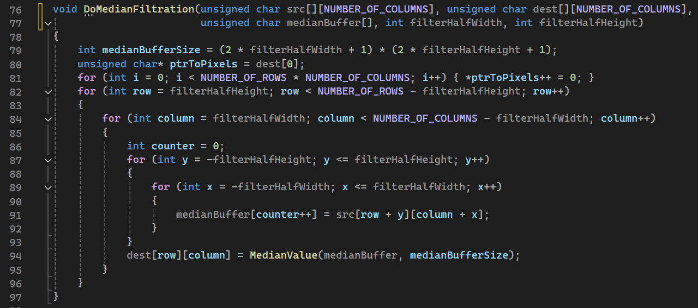
41.5-fifth important function –” DoMedianFiltration” – part 2
First – we will present the inputs of the function – the filtration process is a bit more complicated so we decided to start by explaining the function step by step
src = This is a 2D array of unsigned char representing the source grayscale image to be filtered.
dst = This is a 2D array of unsigned char where the filtered image will be stored.
The purpose of the function is to apply a median filter to a given image.
Previously we explained about the goal of the filter – but in short : creating a new image where each pixel's value is replaced by the median value of the pixels in a neighborhood around it.
medianBuffer = This is an array used to store the neighborhood pixel values for calculating the median.
filterHalfWidth = This is the half-width of the filter window. The full filter width is 2 * filterHalfWidth + 1.
filterHalfHeight = This is the half-height of the filter window. The full filter height is 2 * filterHalfHeight + 1.

Slide 10
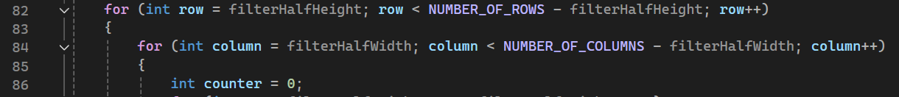
41.5-fifth important function –” DoMedianFiltration” – part 3
The medianBufferSize is calculated as the total number of pixels in the filter window
which is the size of the median buffer
Set all pixels in the destination image to 0. This ensures the destination image is initialized and any pixels not processed by the filter remain zero.
The outer loop iterates over the rows of the image starting from filterHalfHeight to NUMBER_OF_ROWS - filterHalfHeight.
Important to do because it helps us to avoid processing the edges of the image where the filter window would extend outside the image boundaries.
The inner loop iterates over the columns

Slide 11
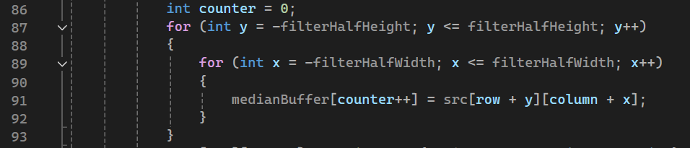
41.5-fifth important function –” DoMedianFiltration” – part 4
Use nested loops to iterate over the neighborhood defined by filterHalfHeight and filterHalfWidth.
Collect pixel values from the source image into medianBuffer. medianBuffer[counter++] stores the pixel value at position (row + y, column + x) from the source image.
Call new function - MedianValue - to compute the median of the pixel values stored in medianBuffer.
Then - Assign the computed median value to the corresponding pixel (row, column) in the destination image.
Next , we will explain about the MedianValue assistance function

Slide 12
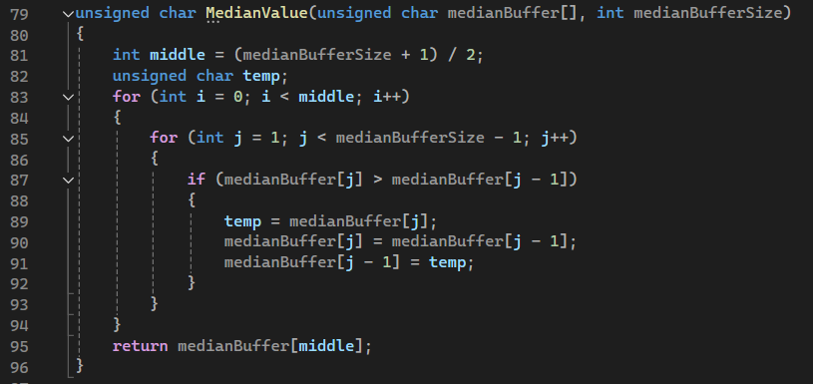
41.6-sixth important function –” MedianValue”
The MedianValue function computes the median of an array of pixel values.
Calculate the middle index of the buffer.
Sort the buffer partially until the middle index. This is a simplified sorting algorithm that ensures the median value is in the correct position.
The function returns the value at the middle index of the partially sorted buffer as the median.

Slide 13
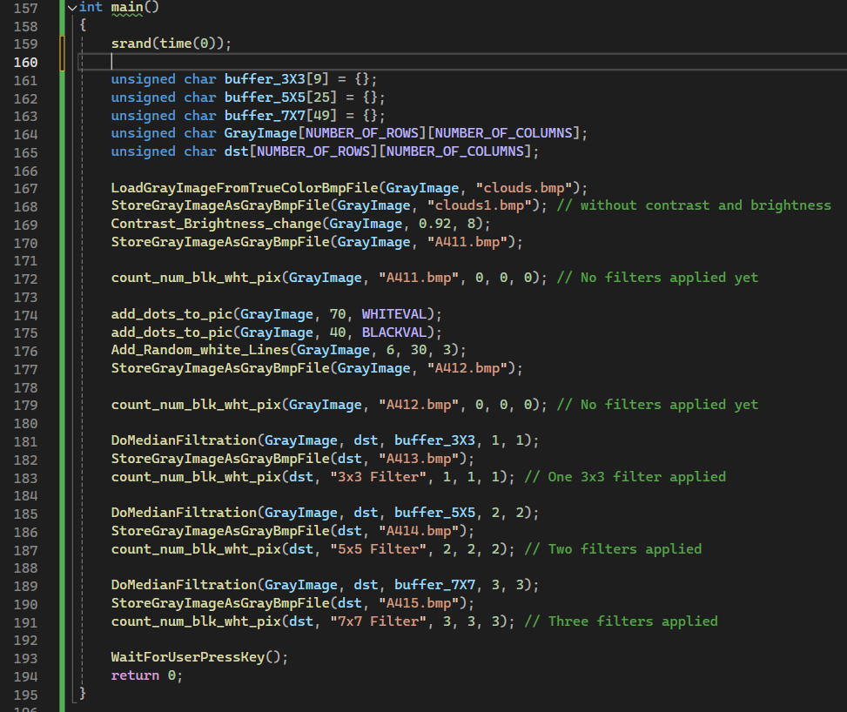
41.7-ninth important function – ”main”
These arrays are initialized to hold pixel values for the images and the median filter buffers:
buffer_3X3, buffer_5X5, and buffer_7X7 are used to store pixel values for median filtering with different filter sizes , GrayImage stores the grayscale image , dst stores the resulting image after applying median filtering.
srand(time(0)) initializes the random number generator with the current time. This ensures that the sequence of random numbers generated in the program will be different each time it runs.
The count_num_blk_wht_pix function is called after each major image processing step. Pay attention to its parameters considering the applied NXN median filter

Slide 14

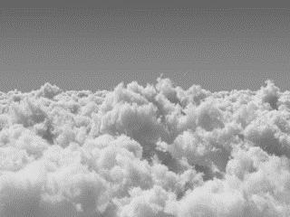

41.8-presentation of the created images by the program – part 1
Clouds.bmp
Clouds1.bmp
A411.bmp
Continue of the created images next slide

Slide 15
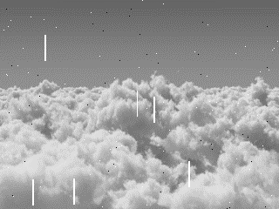
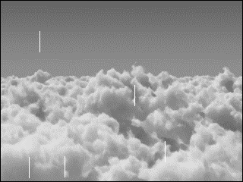
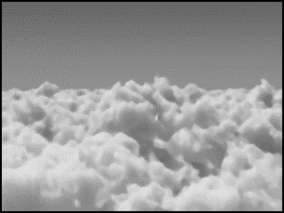

41.8-presentation of the created images by the program – part 3
A411.bmp
A412.bmp
A413.bmp
A414.bmp
A415.bmp

Slide 16
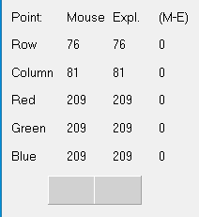
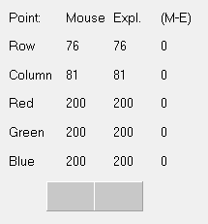
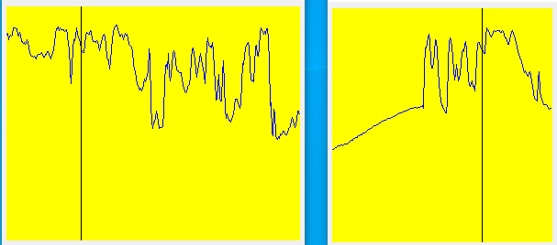
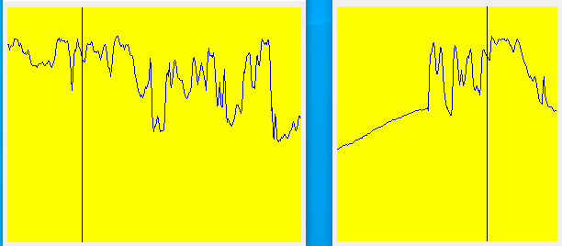
41.8-presentation of the created images by the program – part 4
Clouds1.bmp
A411.bmp
Clouds1.bmp is the grayscale version of the original clouds.bmp color image
A411.bmp is an improved version of clouds1.bmp – improvement in contrast and brightness – in the point explorer one can see improvement from 209 to 200.

Slide 17
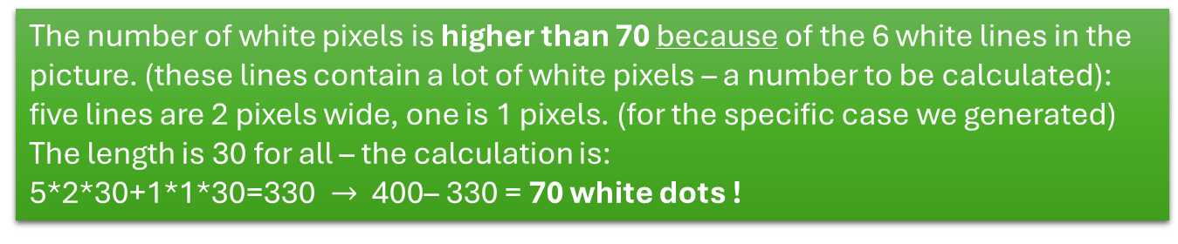
41.8-presentation of the created images by the program – part 5
First and foremost - for verification purposes – we made sure that A411.bmp does not contain white / black pixels that we might count twice on the next stage
A412.bmp
Then, We have added 6 white vertical lines positioned in random locations , the length of the lines is 30 pixels, and the width is between 1 to 3 pixels randomly.
The number of white pixels we have: 70
The number of black pixels we have: 40
The number of white pixels is higher than 70 because of the 6 white lines in the picture. (these lines contain a lot of white pixels – a number to be calculated):
five lines are 2 pixels wide, one is 1 pixels. (for the specific case we generated)
The length is 30 for all – the calculation is:
5*2*30+1*1*30=330 $→$ 400– 330 = 70 white dots !
2
1
2
2
Width of pixels for white lines – checked using BMP views experimentally
2
2

Slide 18
41.8-presentation of the created images by the program – part 6
New lengths of the remaining white noise is specified for further calculation
A412.bmp
A413.bmp
28
Apply 3x3 median filter
28
28
28
28
In this image we can see that after implementing the median filter 3X3 on the image we succeeded to remove all the black and white points and some of the white lines. (and the remaining lines left some of their width and length )
The amount of black pixels is zero thanks to the verification process of the counting function (the black lines on the edges of the image are not taken under account in the counting process)
We can also see that a median filter 3X3 is not enough for cleaning the white lines with a width of 1 pixel.
Amount of white pixels: 140 (only the remaining white vertical lines – calculation : 5*1*30=150 – 2-2-2-2-2= 140
Amount of black pixel: 0

Slide 19
41.8-presentation of the created images by the program – part 7
A412.bmp
A414.bmp
Apply 5x5 median filter
In this image we can see that after implementing a 5X5 median filter on the original image, we succeeded to clean all white and black points and also succeeded cleaning all white lines.
The median filter 5X5 cleaned the image very well and it is the best filter we tried to implement.
The main drawback is the decrease in quality and sharpness of the image!
Number of white pixels: 0
Number of black pixels: 0
Pay attention that we present only one tryout of the random process – in other cases the 5x5 median filter failed to filter all the white lines (few remained but smaller and thiner).

Slide 20
41.8-presentation of the created images by the program – part 8
A412.bmp
A415.bmp
Apply 7x7 median filter
In this image we can see that after implementing a 7X7 median filter on the image we succeeded to clean all white and black points and succeeded to clean all the white lines!
This median filter succeeded to filter all the salt & paper noises and the white lines, but the image looks grain and not very realistic (we lost the sharpness of the original image). ( even worse than after applying 5x5 filter)
We can also see that the frame around the image is very large in compared to the previous median filters.
Important to know is that in every tryout we did – the 7x7 succeeded to clean all the noise (compared to the 5x5 that sometimes succeed but sometimes fails. The prize of the full cleaning is the deprivation in the quality of the image!
Number of white pixels: 0
Number of black pixels: 0

Slide 21
41.9-what did we learn?
1) We learned the differences between filtering with a small matrix (buffer) and filtering with a larger matrix (buffer).
2) We learned how to implement a median filter with different buffers.
3) We learned when a specific size of a filter is fitting our requests for filtering an image.

